Slide 1


Comissió d’Estudi sobre el Deute Històric de l’Estat amb Catalunya
Compareixença de Joan Amorós i Pla
President de FERRMED
Parlament de Catalunya, 7 de març de 2023

Slide 2
FERRMED STUDY OF TRAFFIC AND MODAL SHIFT OPTIMISATION IN THE EU
PRELIMINARY MAIN CONCLUSIONS AND RECOMMENDATIONS

Slide 3
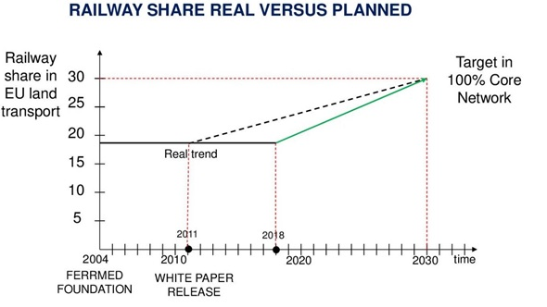
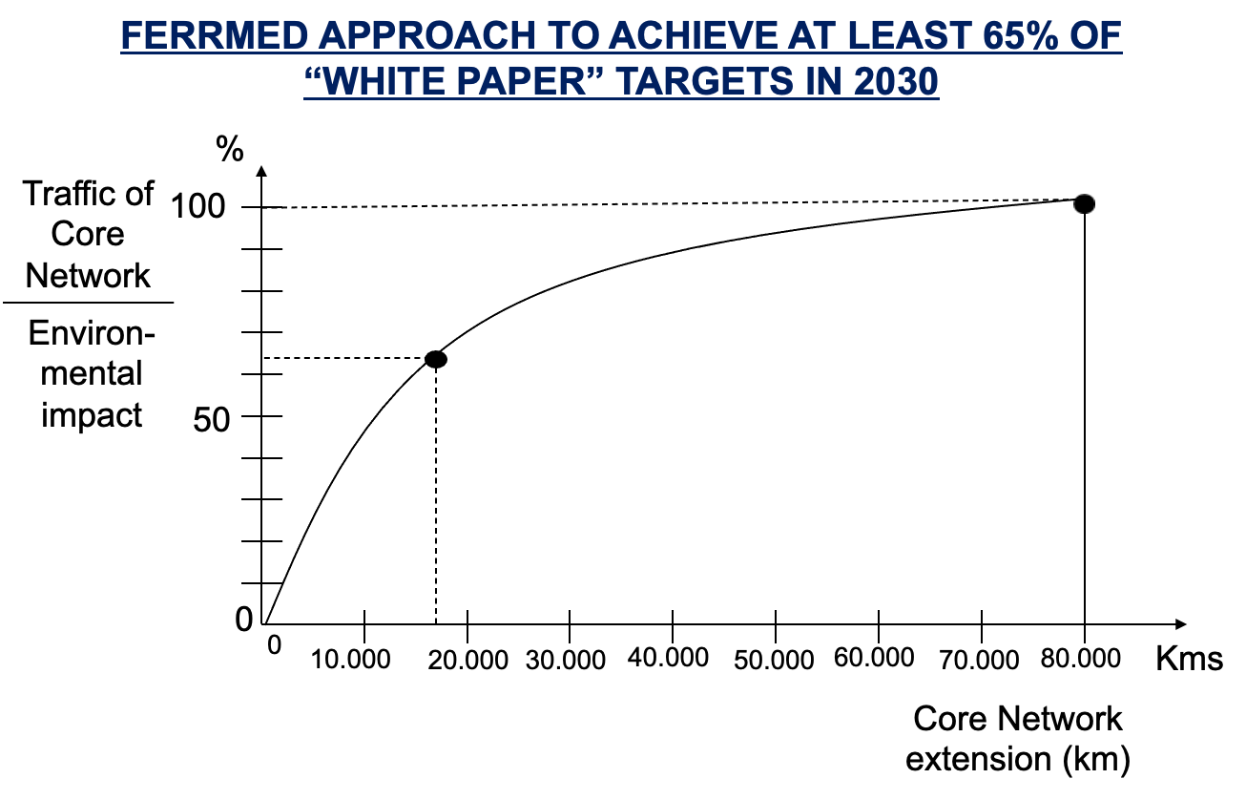
PERFORMANCE AND ENVIRONMENTAL IMPACT OF THE EUROPEAN LAND FREIGHT TRANSPORT SYSTEM
BACKGROUND
In 2015 transport volume in the EU-28 was 19 billion tonnes of goods transported (or 2,385 billion tonne-kilometre). In terms of tonne-kilometre, 75% was transported by road, 18% by rail and 7% by barge.
The major part (around 55%) of total road freight transport performance was over distances of more than 300km of which, roughly one third, where over more than 1000km.
The impact of road freight transport on the environment is massive: some 275 million tonnes of CO2 per annum representing 30% of total GHG emissions of the transport sector as a whole.
Notes:
3
3
3

Slide 4
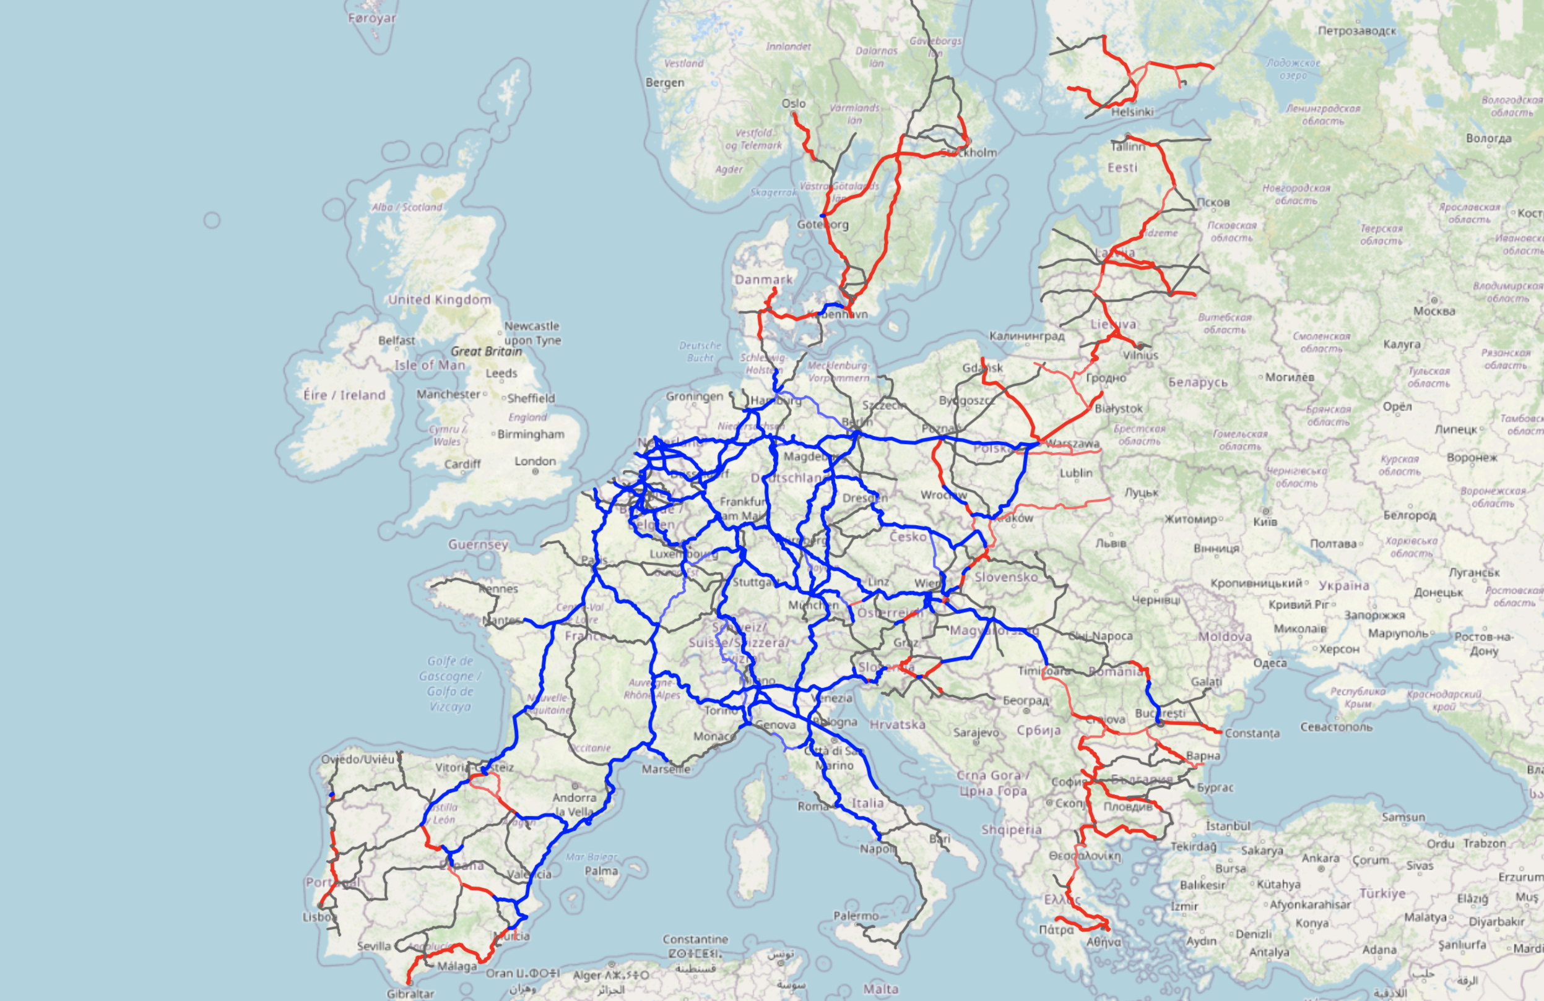
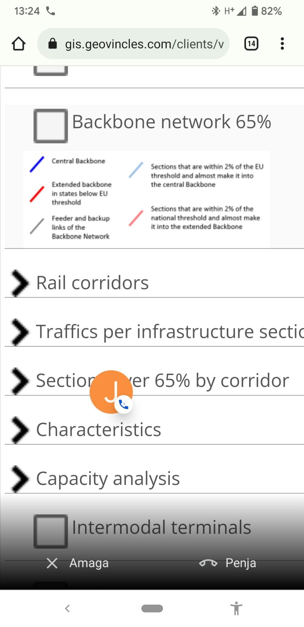
EU BACKBONE NETWORK DETERMINATION
Notes:
4

Slide 5
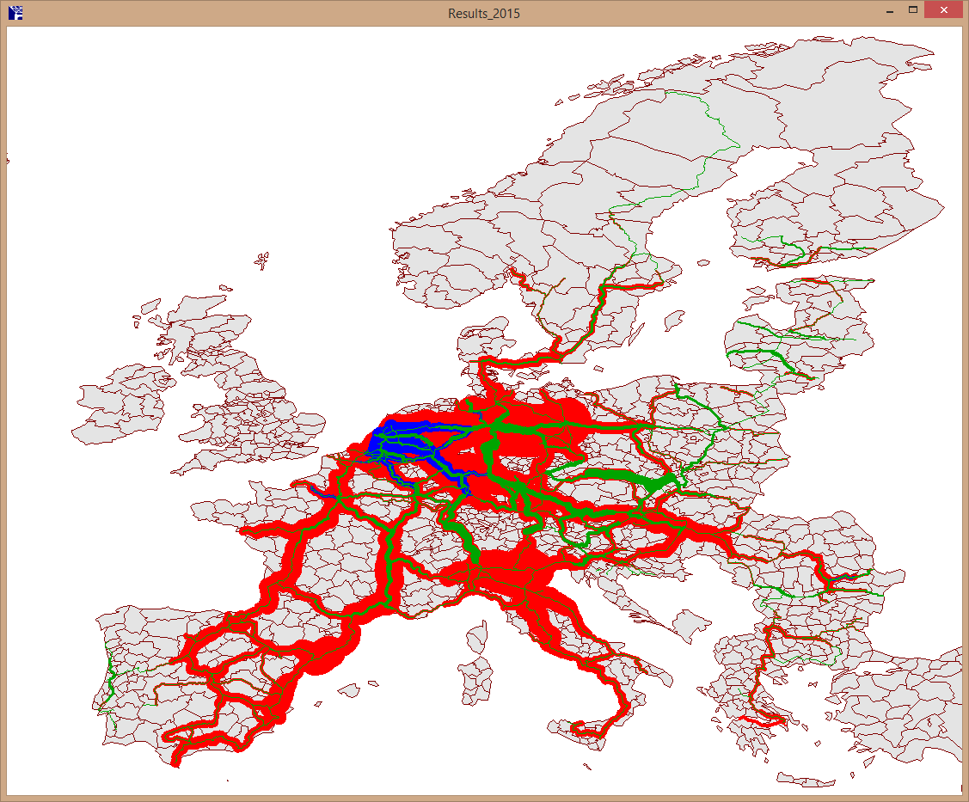
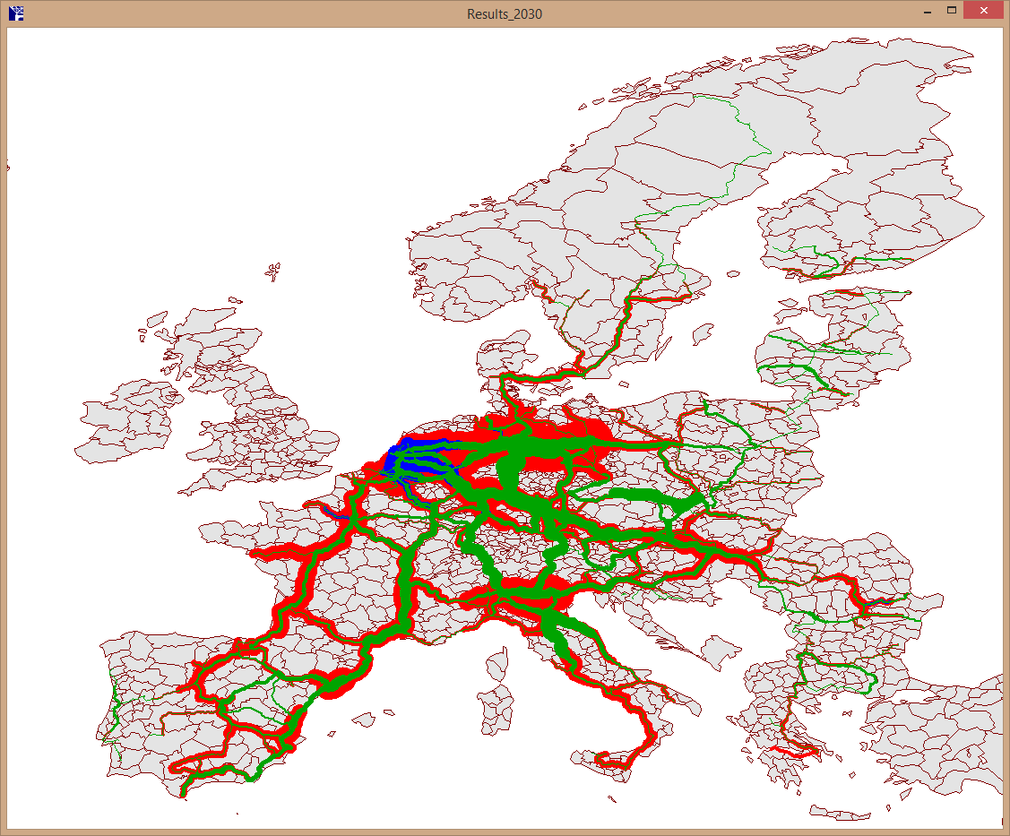
FORECAST TRAFFIC SCENARIOS
  Origin-Destination matrices by mode (road, rail, IWW) coming from ETISPLUS project (official ones used by DGMOVE)
2015
2030
Road
Road
Rail
Rail
IWW
IWW
Notes:
5

Slide 6
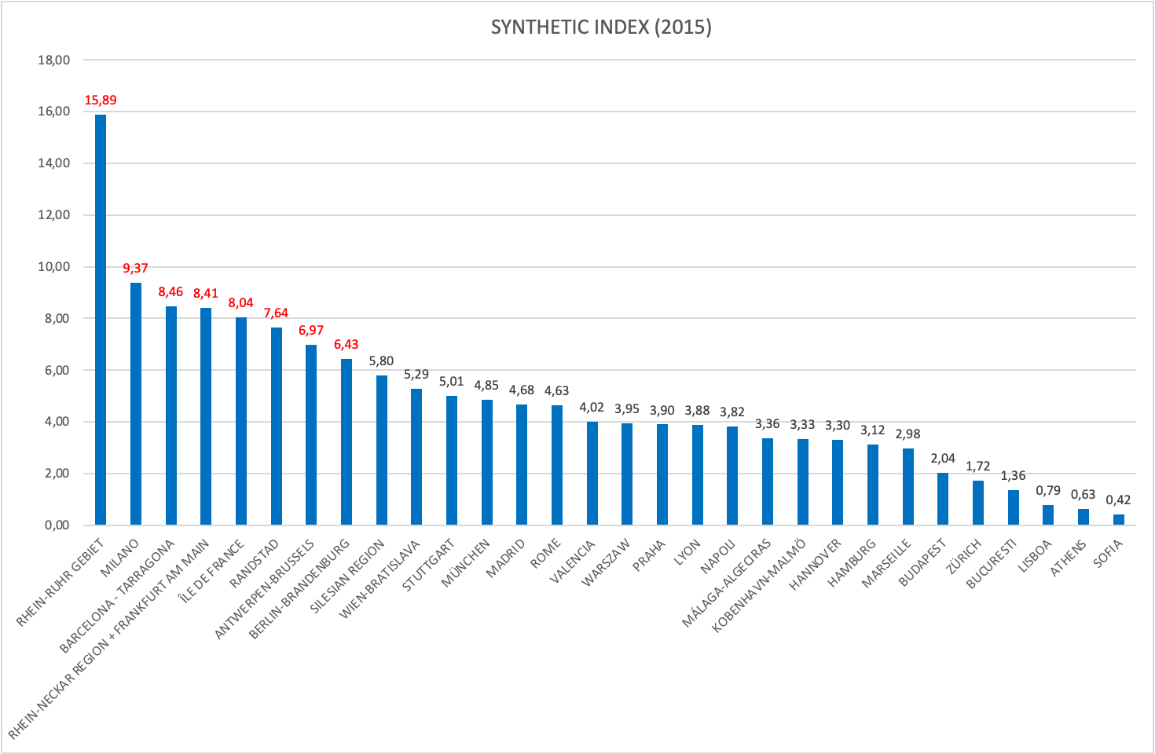
THE HIERARCHICAL DISTRIBUTION OF THE EU STRATEGIC HUBS
Synthetic Index
HUB NAME | Synthetic index
RHEIN-RUHR GEBIET | 15,89
MILANO | 9,37
BARCELONA - TARRAGONA | 8,46
RHEIN-NECKAR REGION + FRANKFURT AM MAIN | 8,41
ÎLE DE FRANCE | 8,04
RANDSTAD | 7,64
ANTWERPEN-BRUSSELS | 6,97
BERLIN-BRANDENBURG | 6,43
SILESIAN REGION | 5,80
WIEN-BRATISLAVA | 5,29
STUTTGART | 5,01
MÜNCHEN | 4,85
MADRID | 4,68
ROME | 4,63
VALENCIA | 4,02
WARSZAW | 3,95
PRAHA | 3,90
LYON | 3,88
NAPOLI | 3,82
MÁLAGA-ALGECIRAS | 3,36
KOBENHAVN-MALMÖ | 3,33
HANNOVER | 3,30
HAMBURG | 3,12
MARSEILLE | 2,98
BUDAPEST | 2,04
ZÜRICH | 1,72
BUCURESTI | 1,36
LISBOA | 0,79
ATHENS | 0,63
SOFIA | 0,42
Values weighting
HUB POP | GVA Ind. | INPUT-OUTPUT
1 | 5 | 10

Slide 7
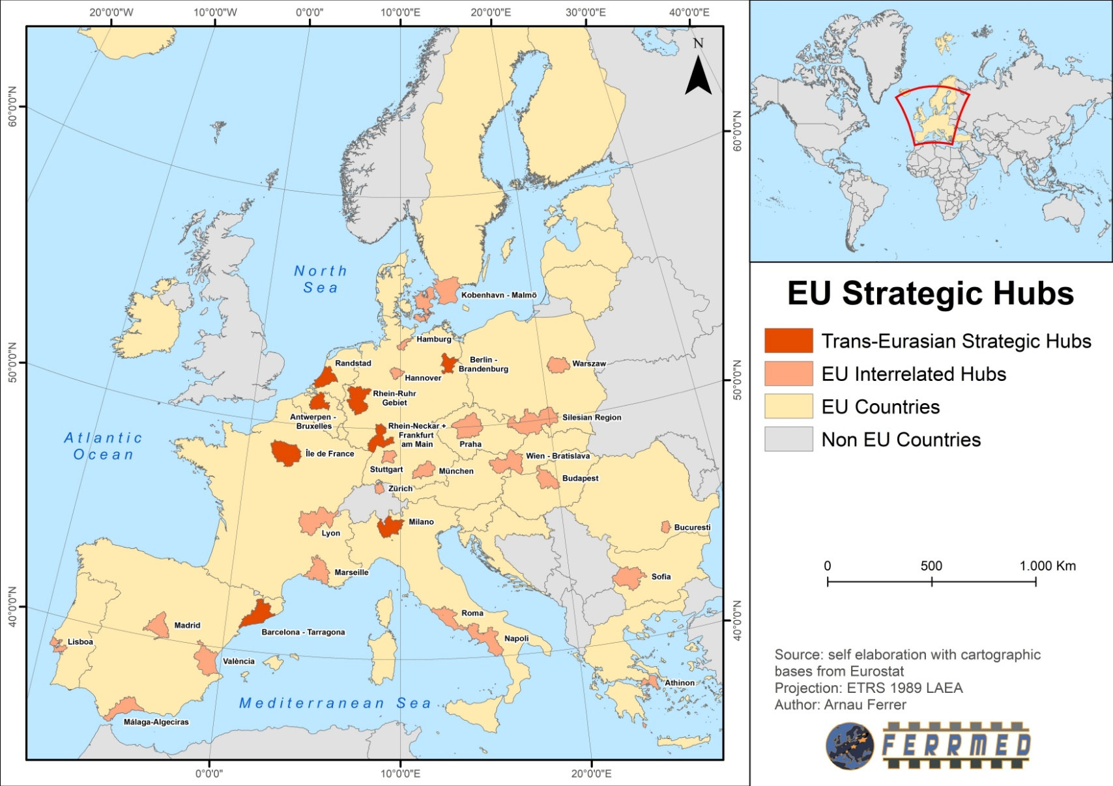
GEOGRAPHICAL DISTRIBUTION OF THE EU STRATEGIC HUBS

Slide 8
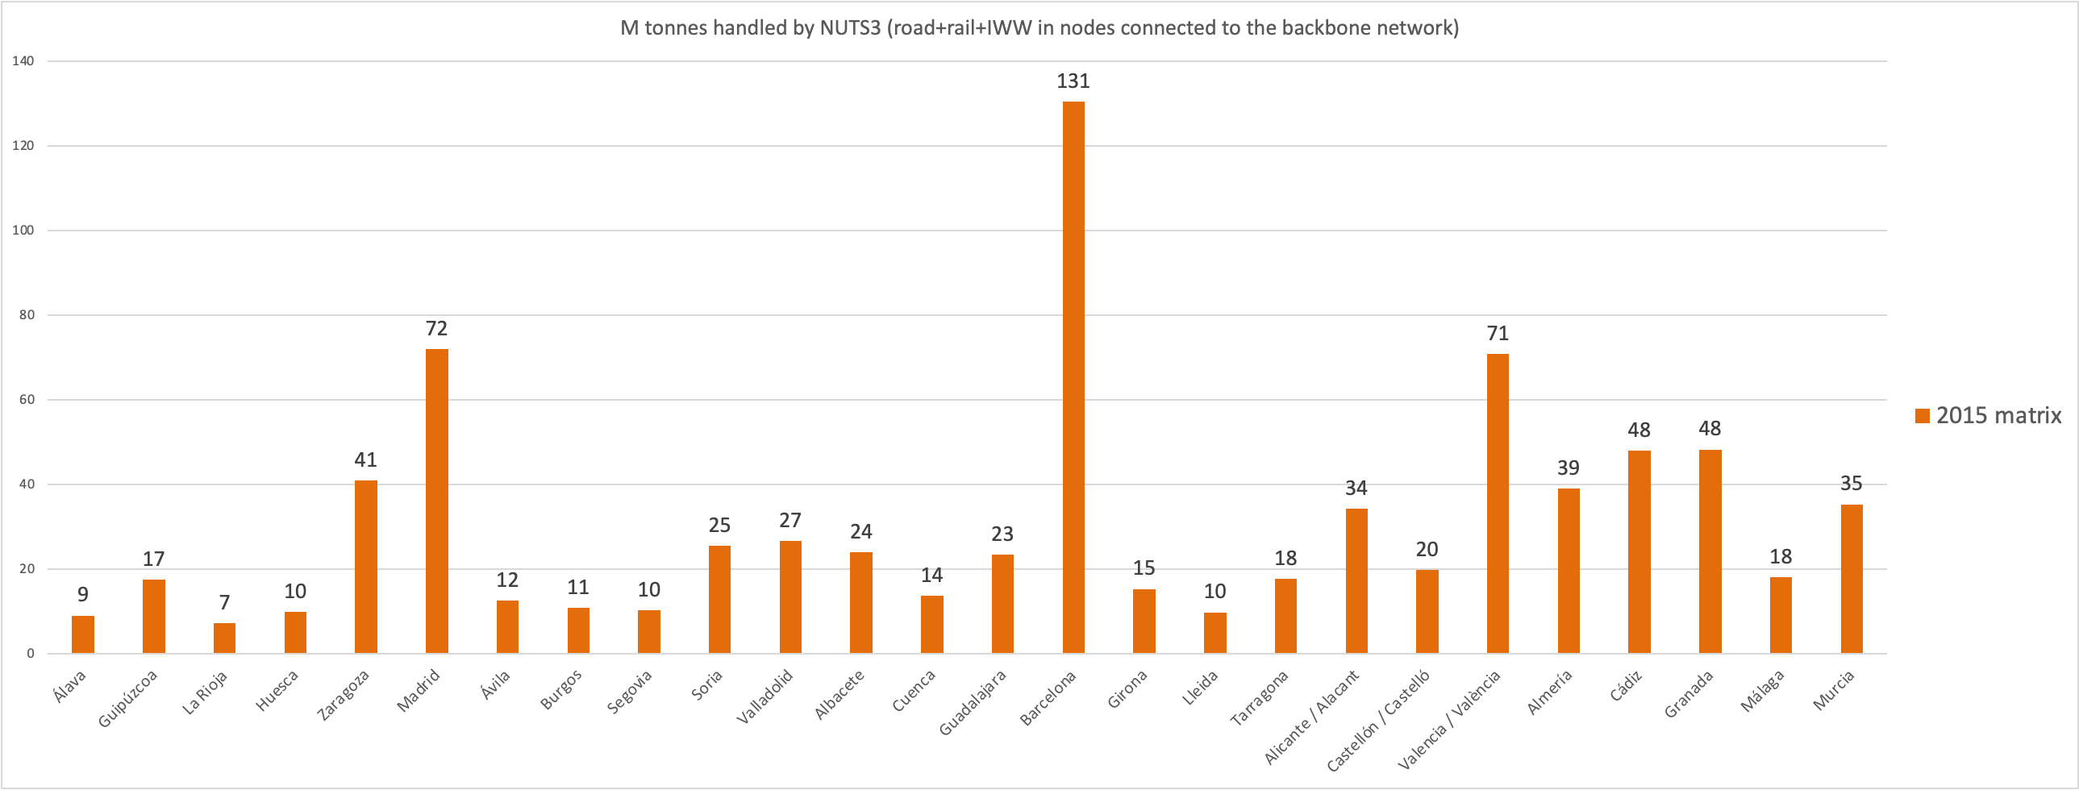
INFLOW-OUTFLOW IN SPANISH NUTS
SPAIN (NUTS3)
(Over 300km)

Slide 9
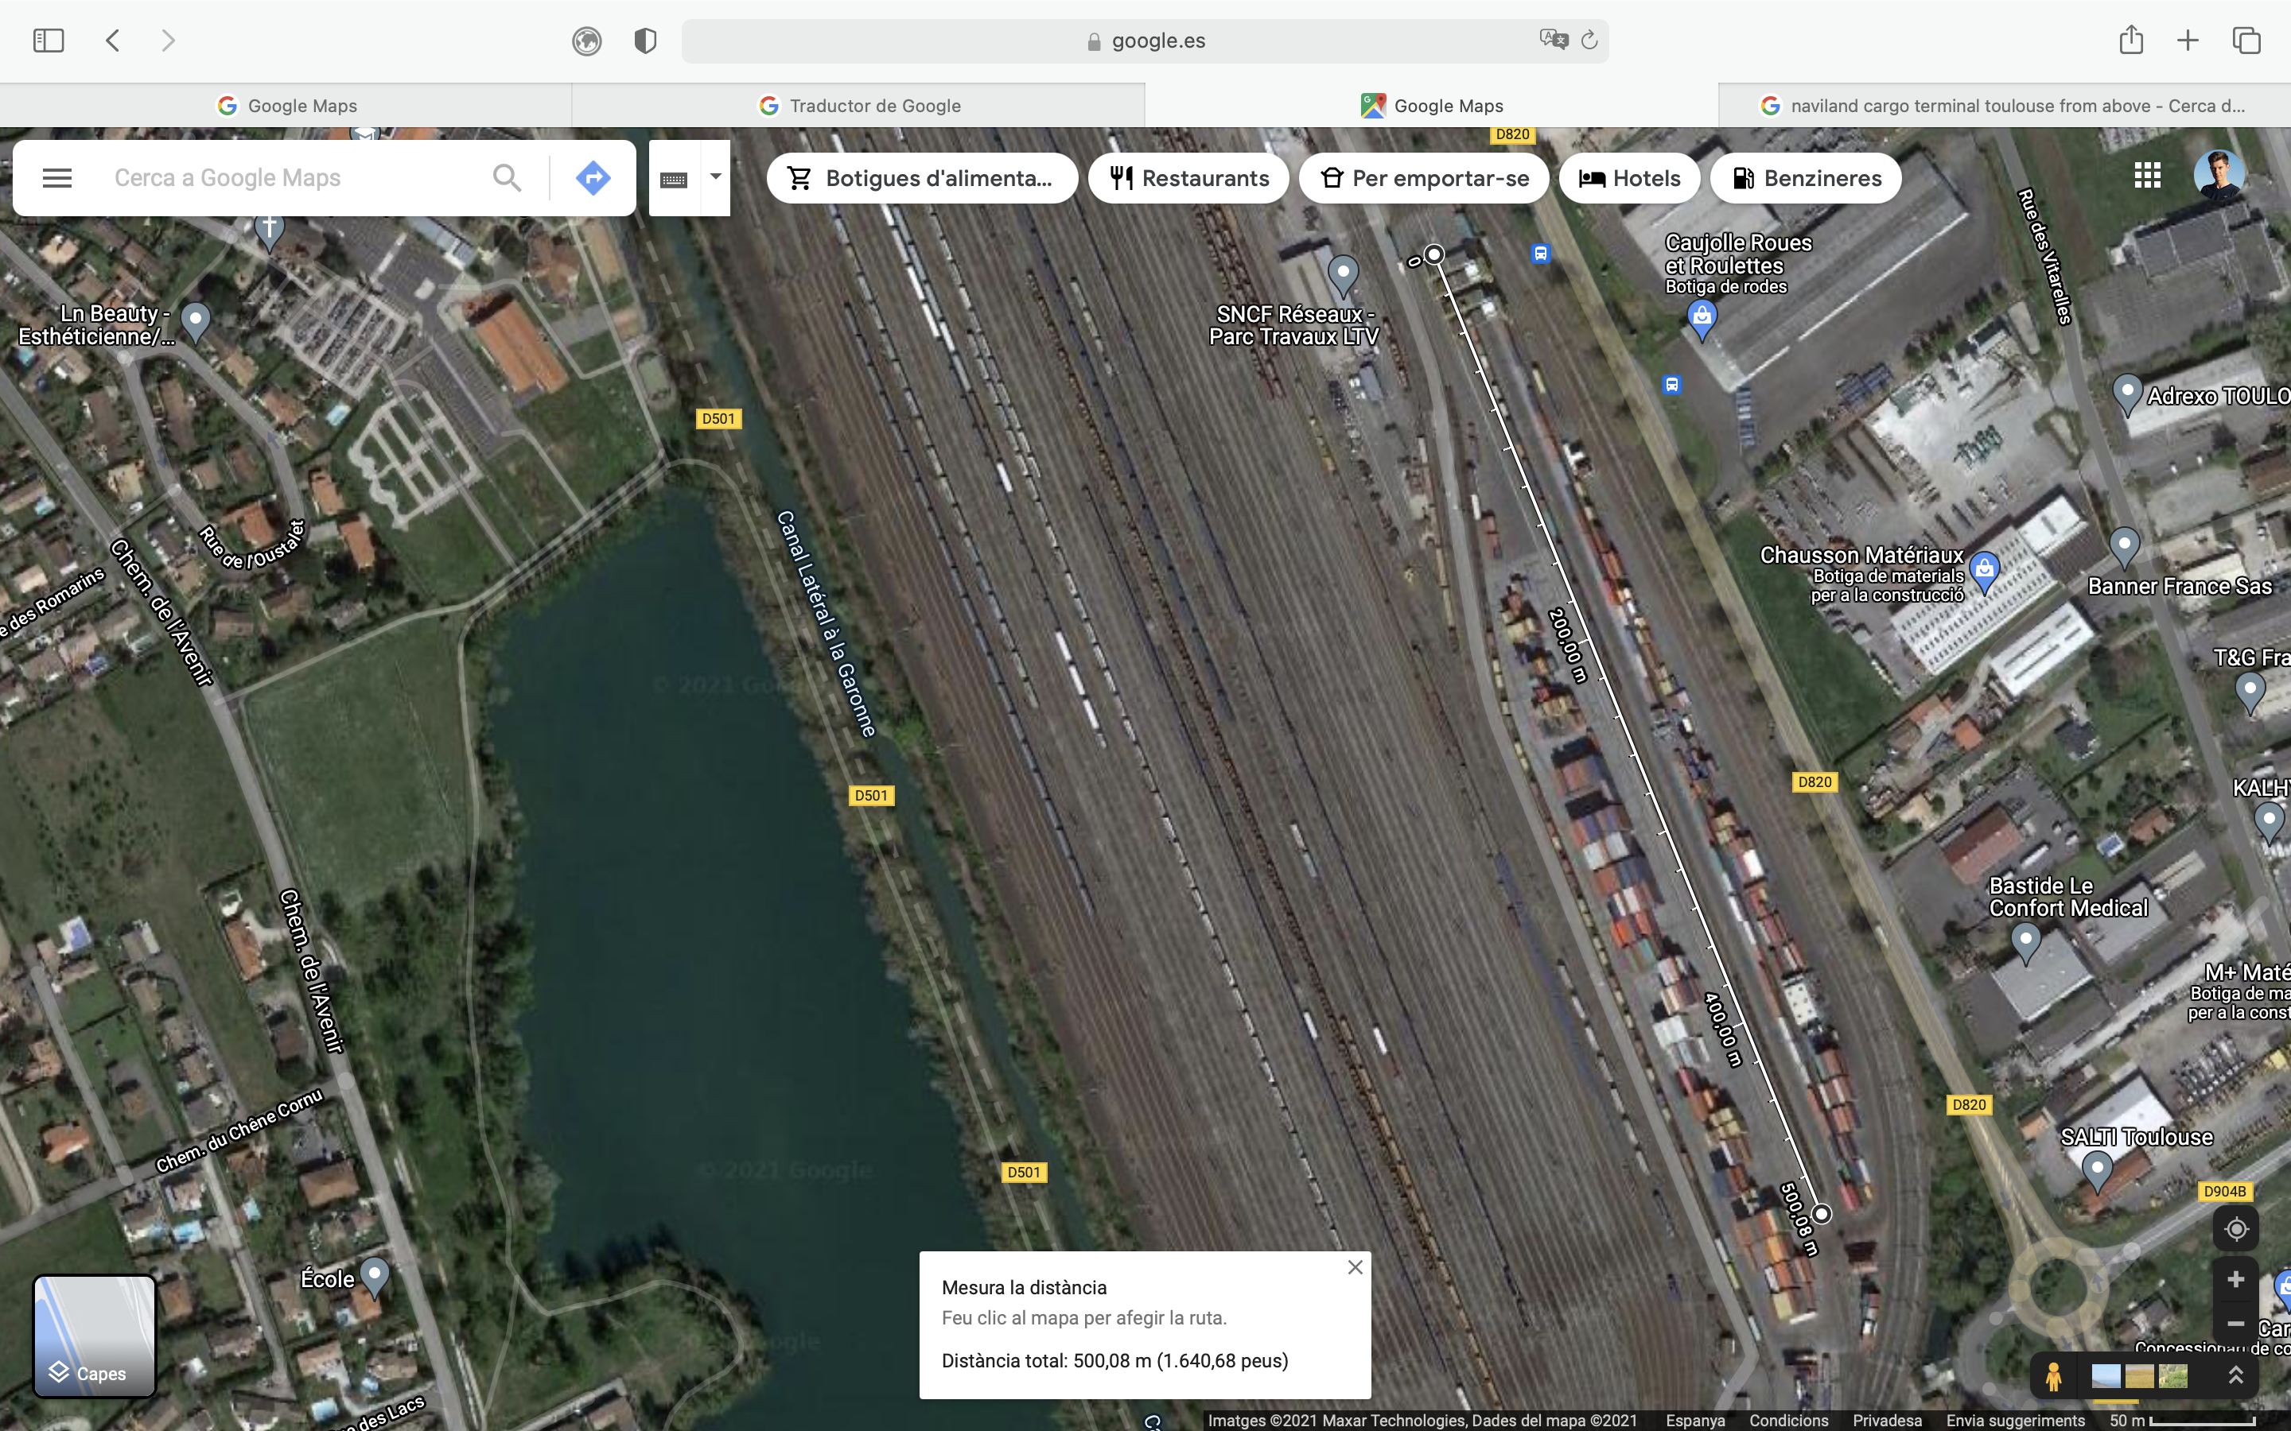
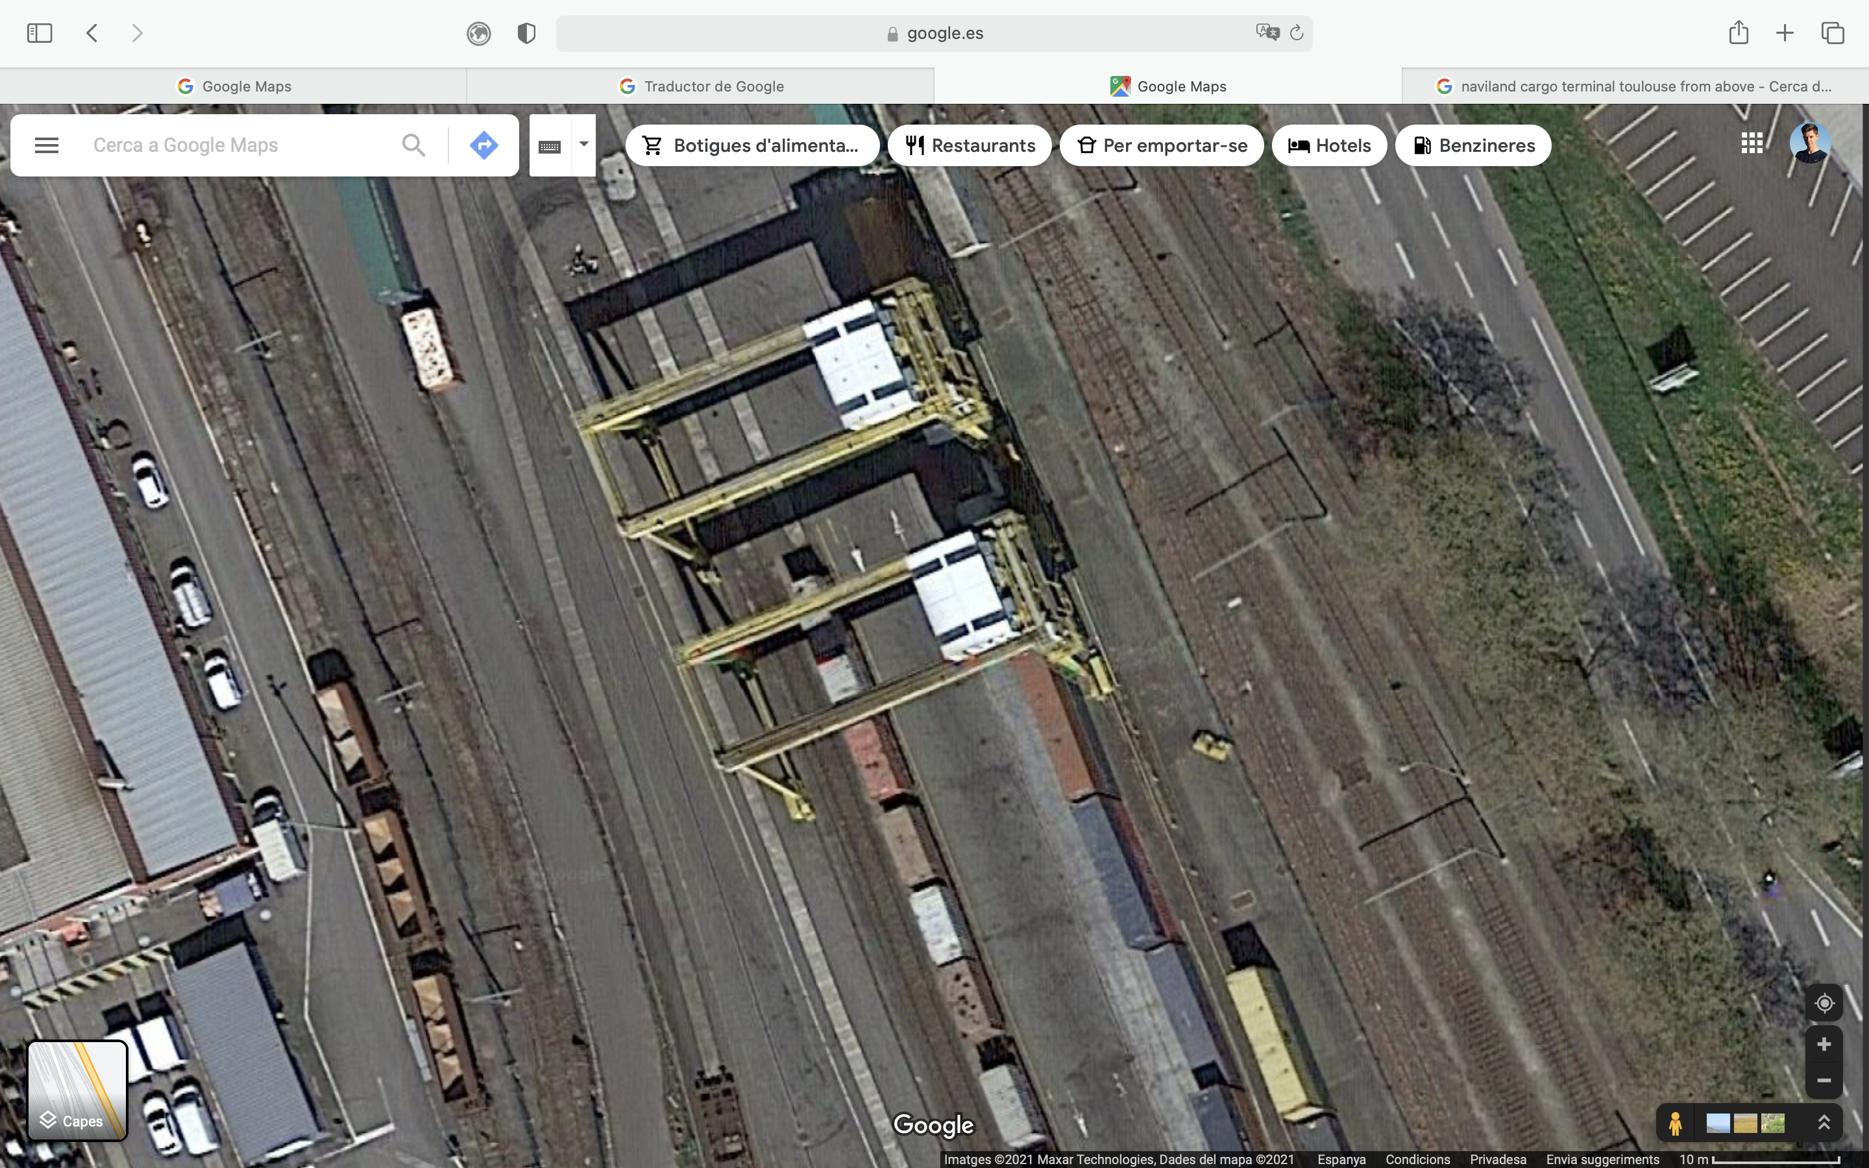
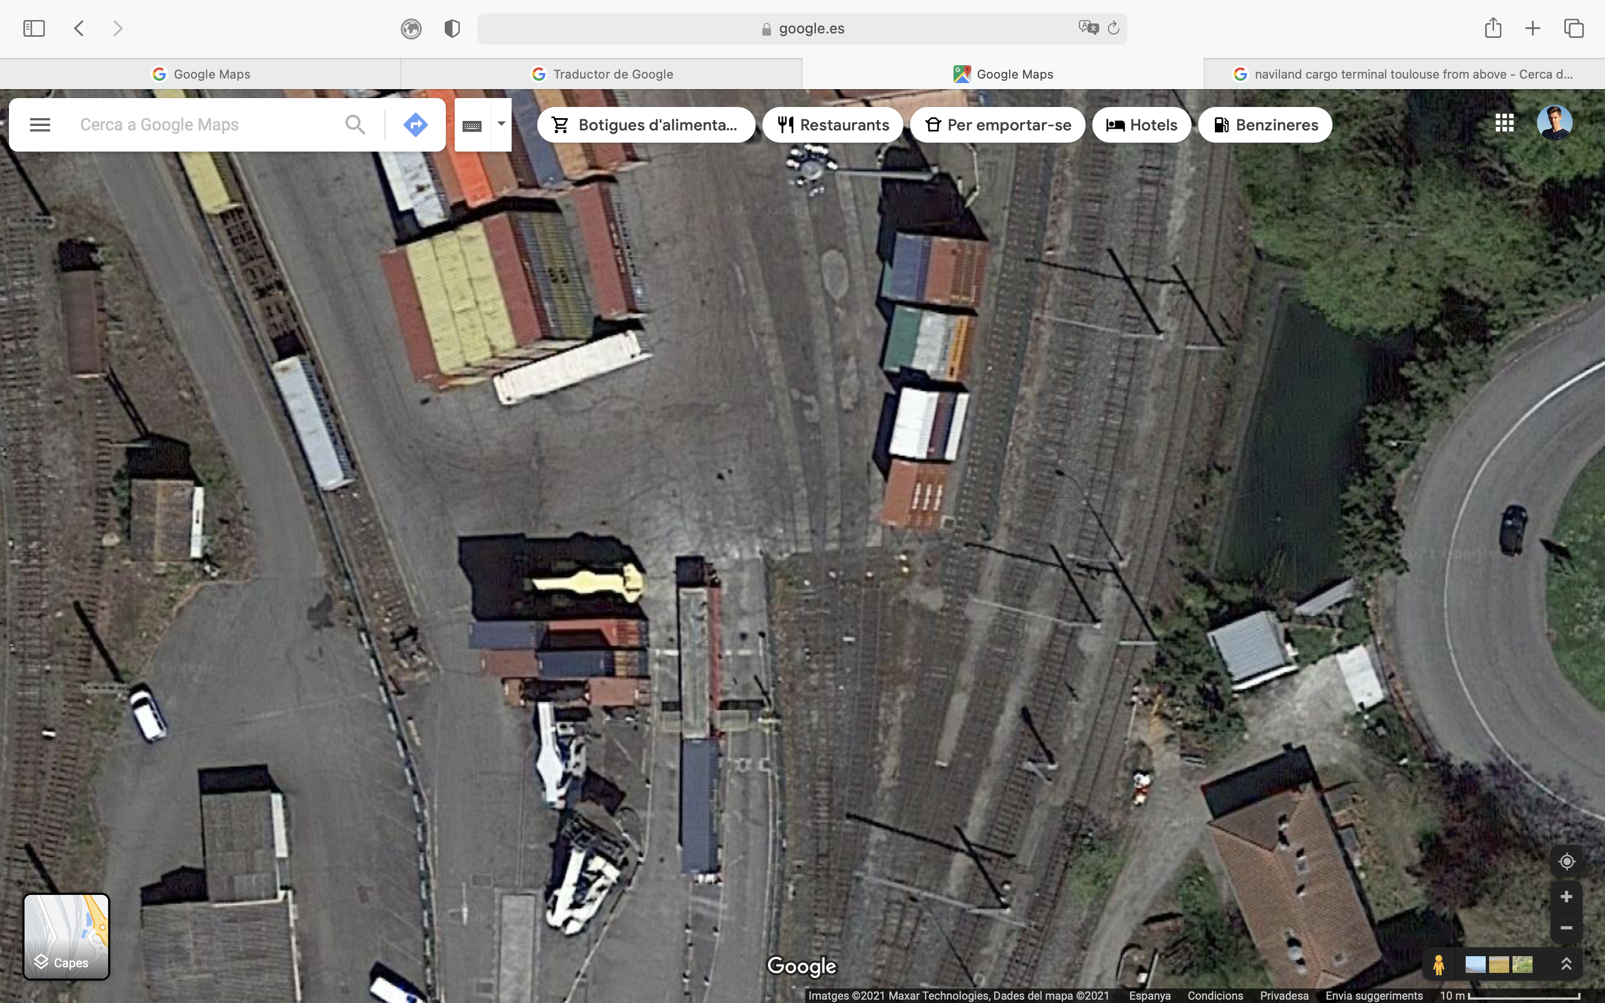
EXAMPLE OF A TERMINAL ANALYSIS: TOULOUSE – FENOULLET CONTAINER TERMINAL (NAVILAND)
INTERMODAL TERMINAL CHARACTERISTICS
MAIN INFORMATION |  |  | Terminal Name: Toulouse-Fenouillet
 |  |  | Terminal Operator: NAVILAND
 |  |  | Latitude º, Longitude º: 43.420169, 1.234257
 |  |  | Address: Route Nationale 20, 31150, Fenouillet
 |  |  | Contact person: Stéphane Tordjman
 |  |  | Function: Service Commercial
 |  |  | General e-mail: stordjman@naviland-cargo.com
 |  |  | General Phone: +33 (0) 5 61 37 51 51
 |  |  | website: http://http://www.naviland-cargo.com/implantations/toulouse
 | CONCEPTS |  | Present conditions | Future conditions
 |  |  |  | expected expansion | year
1 | Modes served: | Road | YES
 |  | Rail | YES
 |  | Barge | -
 |  | Ferry | -
 |  | Sea Vessel | -
 |  | Piggyback | -
 |  | RoLa | -
2 | Opening hours: from: - to: | Mo-Fr | 07:00 - 18:30
 |  | Saturday | -
 |  | Sunday | -
3 | Handling of: | Container | YES
 |  | Swap Body | -
 |  | Semitrailer | -
 |  | Bulk | -
4 | Total Terminal Area (m2): |  | 74.941
 | Capacity for containers storage (m2, TEU)
 | Capacity for swap body storage (m2, no.) |  | -
 | Reefers connection capacity (m2, TEU) |  | -
 | Additional capacity for other products storage |  | -
 | Cars (m2, no.) |  | -
 | Chemicals and dangerous goods (m2) |  | -
 | Bulk, etc. (m2) |  | -
 | Additional Buffer Areas (m2, TEU) |  | -
5 | Rail
 | Number of tracks x Usable length (m) / gauge |  | 1 x 340 | x
 |  |  | 6 x 550 | x
 |  |  |  | x
 |  |  |  | x
 |  |  |  | x
 | Total no.of tracks / Total usable length (m) |  | 7 x 3.640 | /
 | Marshalling yard capability YES / NO |  | YES
 | If not, name of next marshalling yard and distance (m)
 | Connection with main rail lines (name/bounds)
Number of gantry cranes
Length of the tracks
Number of reach-stackers

Slide 10
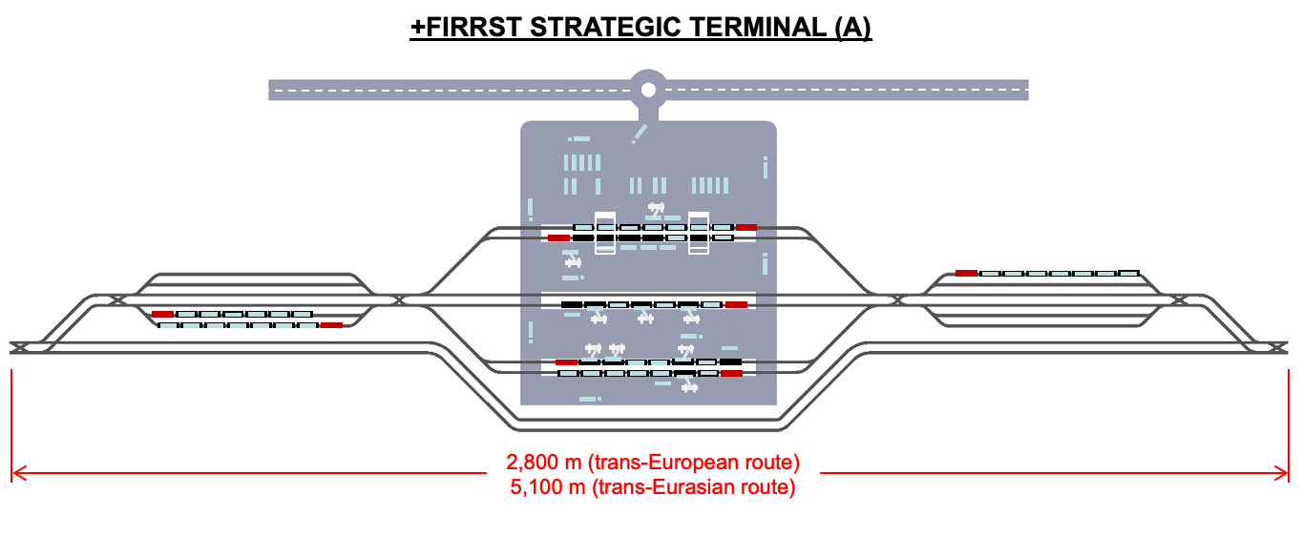
MAIN CONCLUSIONS
INTERMODAL TERMINALS CONSIDERATIONS
Notes:
10
10
10

Slide 11
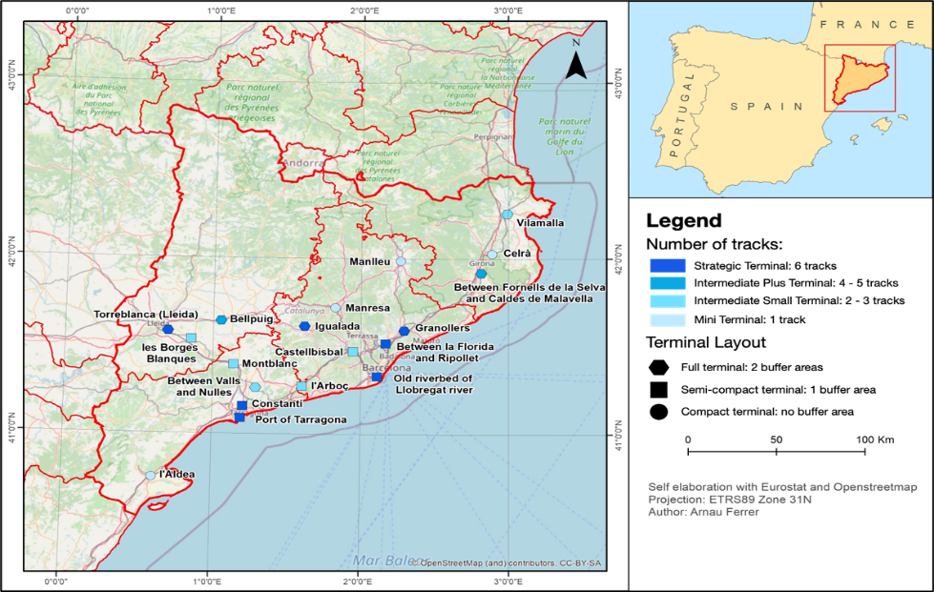
MAPA DE LES TERMINALS +FIRRST A CATALUNYA
Notes:
11

Slide 12
NOVES TERMINALS INTERMODALS A CATALUNYA
Noves terminals intermodals
  Demarcació de Girona: Vilamalla, Celrà, Fornells de la Selva
  Demarcació de Barcelona: Granollers, La Florida, antiga llera del Llobregat, Castellbisbal, Igualada, Manresa, Manlleu
  Demarcació de Lleida: Torreblanca, Bellpuig, Les Borges Blanques
  Demarcació de Tarragona: L’Arboç, La Boella, Constantí, Nulles, Montblanc, L’Aldea
Notes:
12

Slide 13
CONFLUENCE BETWEEN EBRO AXIS – MEDITERRANEAN AXIS (DAILY FREIGHT VOLUMES)
(EU threshold (65%) = 122,000 t/day)
12 bottlenecks identified by 2030 in the whole Mediterranean Axis, 7 of them located in this zone
129.653 t/day
~35.000 t/day
Lleida
139.194 t/day
223.096 t/day
24.552 t/day
Martorell/
Castellbisbal
397.091 t/day
32.960 t/day
190.760 t/day
Barcelona
Sant Vicenç
de Calders
166.208 t/day
 |  |  | Required | Planned | In works
Required actions | INTERCONN. LINKS |  | 18 | 8 | 2
 | INTERMODAL TERMINALS | NEW | 13 | 4 | -
 |  | UPGR. | 4 | 1 | 1
138.010 t/day
Tarragona
Notes:
13
13

Slide 14
ACTUACIONS REQUERIDES A LA XARXA FERROVIÀRIA DE CATALUNYA
Resoldre la problemàtica del Triangle “Barcelona – Lleida – Tarragona”. Conversió de Lleida i rodalies en un gran pol logístic de l’Eix de l’Ebre
Noves línies
  Sant Celoni – Mollet (per segregar mercaderies i rodalies)
  Castellbisbal – Martorell – Vilafranca – St. Vicenç – Constantí – Reus
      by-pass Castellbisbal – Martorell (SEAT) per segregar mercaderies i rodalies
      afegir una via més a la línia actual fins a St. Vicenç
      refer la línia abandonada St. Vicenç – Roda – Constantí – Reus
  Cervera – Igualada – Martorell (nou traçat)
  Lleida – Tortosa (nou traçat)
  Tarragona – València (alta velocitat)
  Nous accessos als ports de Barcelona i Tarragona
  Nous accessos, passants interconnectats, als aeroports de Barcelona, Girona i Reus
  Noves línies de rodalies a l’Àrea Metropolitana de Barcelona
Notes:
14

Slide 15
ACTUACIONS REQUERIDES A LA XARXA FERROVIÀRIA DE CATALUNYA
Reformar les línies actuals
  Saragossa – Lleida – Tarragona/Valls – Sant Vicenç: conversió a ample internacional en via doble
  Tarragona – Vila-seca – L’Aldea/Tortosa – Castelló – València: conversió a ample internacional
  Conversió a ample mixt de la línia Castellbisbal – Martorell – Sant Vicenç – Tarragona – Reus – Casp – Saragossa
  Conversió a ample internacional de totes les restants línies convencionals de Catalunya
  Desdoblar la línia Montcada – Puigcerdà en el tram Montcada – Manlleu/Ripoll i connexió directa amb la línia Barcelona – Portbou a Granollers sentit nord
Notes:
15

Slide 16
ACTUACIONS REQUERIDES A LA XARXA FERROVIÀRIA DE CATALUNYA
Total investment in Catalonia in M€*
Links | EU/Member State | 6.060
 | FERRMED | 14.071
Terminals | EU/Member State | 226
 | FERRMED | 286
 | Total | 20.643
*Expropriations not included
Notes:
16

Slide 17
FERRMED STUDY OF TRAFFIC AND MODAL SHIFT OPTIMISATION IN THE EU
ÀMBIT DEL CORREDOR MEDITERRANI
Estat Espanyol
Inversions segons el pla del Ministeri de Foment presentat a Barcelona l’any 2011, afegint alguns trams ferroviaris mancants estudiats per FERRMED.
Resoldre la problemàtica de les Rodalies de Barcelona i València.
Línia doble des de la frontera francesa fins a Algesires.
Noves terminals i reconversió/ampliació d’algunes de les existents en tot el recorregut i nous accessos als ports de Castelló, Cartagena, Sagunt i Almería.
República Francesa
By-pass Est per a mercaderies a l’aglomeració de Lyon.
Nova línia Montpeller – Perpinyà.
Noves terminals i reconversió/ampliació d’algunes de les existents en tot el recorregut.
Notes:
17

Slide 18
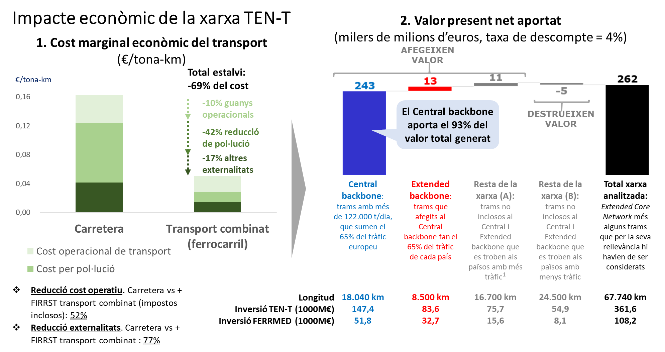
IMPACTE ECONÒMIC DE LA XARXA TEN-T
Aquests països són Alemanya, Àustria, Bèlgica, Eslovàquia, França, Hongria, Itàlia, Països Baixos i la República Txeca.
Font: FERRMED (2022), dades preliminars al desembre de 2022 (alguns detalls podrien diferir de les publicades a l’informe final l’any 2023).
Notes:
18
18
18

Slide 19
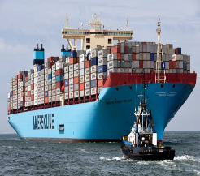
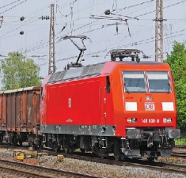
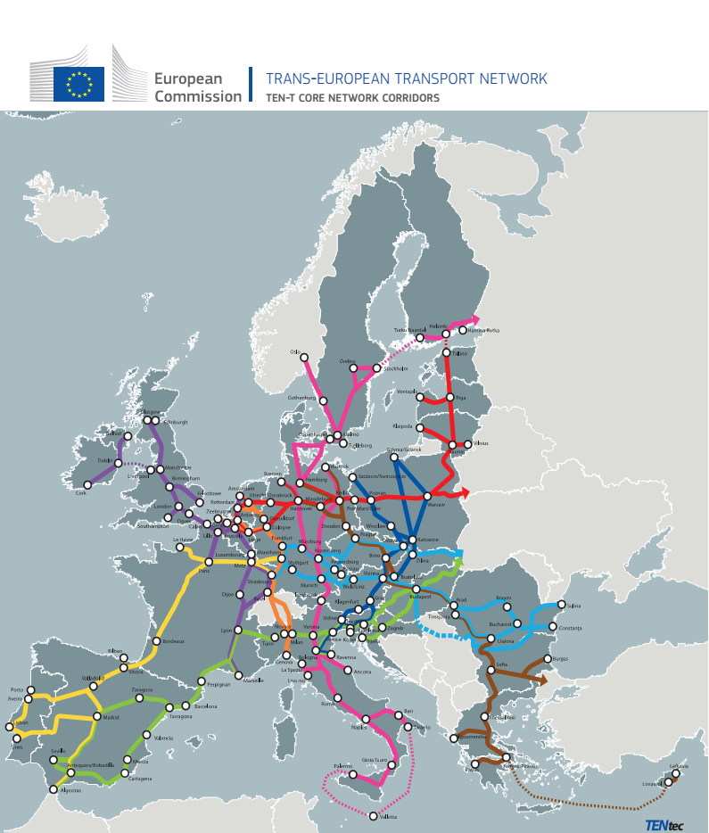

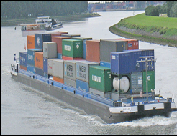
FERRMED Study of Traffic and Modal Shift Optimization in the EU
“The highest profitable way to attain an efficient and sustainable EU transport system”
MOLTES GRÀCIES PER LA VOSTRA ATENCIÓ

Slide 20
Detailed investments required in Catalonia
 |  | SECTIONS EU/ES |  | COST | SECTIONS FERRMED |  | COST | TERMINALS EU/ES |  | COST | TERMINALS FERRMED |  | COST
FROM | TO | Actions Identified | Priority | EU | Proposed Actions FERRMED | Priority | FERRMED | Actions Identified | Priority | EU TERMINAL COST | Proposed Actions FERRMED | Priority | FERRMED TERMINAL COST
Figueres | Portbou | Projected the conversion of iberian gauge to mixed gauge. As a whole for the Madrid - Zaragoza - Barcelona - Portbou line, the completely gauge change is forecasted to finish by 2030 with an estimated cost of 2,4 billion € +P-410 | 2.1 | 102 | To convert one of the tracks between Figueres-Portbou (the right side one) from Iberian gauge to UIC gauge in order to have a back-up line with UIC gauge. To be finished by 2025 | 2.1 | 60 |  |  |  | New +FIRRST intermediate small full terminal in Vilamalla: 1 fast track + 1 fast/moderate + 1 moderate/slow track. Able for 1.500m long trains | 2.2 | 12
Figueres | Portbou |  |  |  | The second track (the left one) (with iberian gauge) will be converted to UIC by 2030 | 2.2 | 60 |  |  |  | Llancà station (enlargement): to enlarge 2 of the current tracks (on the lefts side) until reaching 750m. | 2.2 | 1
Figueres | Portbou | ERTMS implementation | 2.1 | 13 | To construct a new by-pass for freight in Figueres with UIC gauge connecting the new terminal in Vilamalla to the Portbou line | 2.2 | 70
Figueres | Portbou | Adaptation of the line for trains up to 740m | 2.1 | 16
Sant Celoni | Figueres | Projected the conversion of iberian gauge to mixed gauge. As a whole for the Madrid - Zaragoza - Barcelona - Portbou line + P410 gauge, the completely gauge change is forecasted to finish by 2030 with an estimated cost of 2,4 billion € | 2.2 | 245 | Recommended: To implement the UIC gauge instead of mixed gauge | 2.2 |  |  |  | 3 | New +FIRRST intermediate+ semi-compact between Riudellots de la Selva and Caldes de Malavella: 1 fast track + 1 fast/moderate track + 2 moderate/slow tracks able for 1500m long trains | 3.1 | 16
Sant Celoni | Figueres | ERTMS implementation | 2.1 | 41 |  |  |  |  |  |  | New +FIRRST mini terminal in Celrà: 1 fast track able for 1500m long trains | 3.1 | 4
Sant Celoni | Figueres | Adaptation of the line for trains up to 740m | 2.1 | 49
Granollers | Sant Celoni | Projected the conversion of iberian gauge to mixed gauge and the adapattion of the line for trains up to 740m. As a whole for the Madrid - Zaragoza - Barcelona - Portbou line, the completely gauge change is forecasted to finish by 2030 with an estimated cost of 2,4 billion € +P-410 | 2.2 | 59 | Construction of a new track for freight with UIC gauge segregated from the conventional passenger one. Recommended to implement UIC gauge instead of mixed gauge. | 2.2 | 264

Slide 21
Detailed investments required in Catalonia
 |  | SECTIONS EU/ES |  | COST | SECTIONS FERRMED |  | COST | TERMINALS EU/ES |  | COST | TERMINALS FERRMED |  | COST
FROM | TO | Actions Identified | Priority | EU | Proposed Actions FERRMED | Priority | FERRMED | Actions Identified | Priority | EU TERMINAL COST | Proposed Actions FERRMED | Priority | FERRMED TERMINAL COST
Granollers | Sant Celoni | ERTMS implementation | 2.1 | 10
Granollers | Sant Celoni | Adaptation of the line for trains up to 740m | 2.1 | 12
Mollet | Granollers | Projected the conversion of iberian gauge to mixed gauge. As a whole for the Madrid - Zaragoza - Barcelona - Portbou line, the completely gauge change is forecasted to finish by 2030 with an estimated cost of 2,4 billion € +P-410 | 3.1 | 34 | To construct an additional track with UIC gauge for freight in order to avoid future bottlenecks with the increase of commuter trains | 3.1 | 120 |  |  |  | Granollers mercaderies terminal with +FIRRST system implementation: currently it has 4 tracks between 340 and 400m for containers. These tracks must be enlarged to the South until reaching 750m and must be converted to +FIRRST tracks and passing-through. To construct 2 new tracks for the +FIRRST system so that the terminal would have a total number of 6 tracks for the +FIRRST: 1 fast track + 2 fast/moderate tracks + 3 moderate/slow tracks. The composition tracks will be able for 1.500m long trains. | 2.2 | 7
Mollet | Granollers | ERTMS implementation | 2.1 | 4 | New interconnection link between the Barcelona-Puigcerdà and the Barcelona-Portbou line in Montmeló | 2.2 | 140 |  |  |  | New +FIRRST in Manlleu | 3.2 | 10
Mollet | Granollers | Adaptation of the line for trains up to 740m | 2.1 | 5 | Recommended: To completely implement the UIC gauge instead of changing it to mixed gauge | 2.1
Mollet HSL | Figueres HSL |  |  |  | New siding track of 1.700m between Sant Celoni - Hostalric | 3.1 | 31
Mollet HSL | Figueres HSL |  |  |  | New siding track of 1.700m in Southern Figueres side by side to Vilamalla terminal | 3.1 | 31

Slide 22
Detailed investments required in Catalonia
 |  | SECTIONS EU/ES |  | COST | SECTIONS FERRMED |  | COST | TERMINALS EU/ES |  | COST | TERMINALS FERRMED |  | COST
FROM | TO | Actions Identified | Priority | EU | Proposed Actions FERRMED | Priority | FERRMED | Actions Identified | Priority | EU TERMINAL COST | Proposed Actions FERRMED | Priority | FERRMED TERMINAL COST
Castellbisbal | Mollet | ERTMS implementation+P-410 | 2.1 | 39 | To construct an additional track with UIC gauge for freight in order to avoid future bottlenecks with the increase of commuter trains | 3.1 | 324 | Implementation of the mix gauge in La Llagosta terminal and connection to the Mediterranean Corridor in UIC gauge. Enlargement of the terminal. Works are forecasted to finish by 2026 with an estimated cost of 81 million € | 2.1 | 86 | Ripoll, Manlleu and Vic stations (enlargement): to enlarge the current tracks of the stations until reaching 800m | 3.2 | 2
Castellbisbal | Mollet |  |  |  | Adaptation of the line for trains up to 1500m | 2.1 | 68 |  |  |  | New +FIRRST strategic semi-compact terminal in La Florida: 2 fast tracks + 2 fast/moderate track + 2 moderate/slow tracks able for 1500m long trains | 3.1 | 9
Castellbisbal | Mollet |  |  |  | To construct 2 new siding tracks of 900m in Hostalets de Balenyà (Puigcerdà line) | 2.2 | 16 |  |  |  |  |  | 2
Barcelona (Port/ZF) | Castellbisbal | New access to the Port of Barcelona | 2.2 | 280 | New access to the Airport of Barcelona with a passing-through line with UIC gauge | 3.1 | 280 | Projected a new railway terminal in the old riverbed of Llobregat | 2.2 | 15 | New +FIRRST strategic semi-compact terminal in the old riverbed of the Llobregat river: 2 fast tracks + 2 fast/moderate tracks + 2 moderate/slow tracks able for 1500m trains | 3.1 | 40
Barcelona (Port/ZF) | Castellbisbal | ERTMS implementation | 2.1 | 12
Barcelona (Port/ZF) | Castellbisbal | Adaptation of the line for trains up to 740m | 2.1 | 15 |  |  |  | To develop 2 new terminals in the future southern dock of the Port of Barcelona: each terminal must have: 8 tracks for containers with 3 gantry cranes | 3.2 | 26

Slide 23
Detailed investments required in Catalonia
 |  | SECTIONS EU/ES |  | COST | SECTIONS FERRMED |  | COST | TERMINALS EU/ES |  | COST | TERMINALS FERRMED |  | COST
FROM | TO | Actions Identified | Priority | EU | Proposed Actions FERRMED | Priority | FERRMED | Actions Identified | Priority | EU TERMINAL COST | Proposed Actions FERRMED | Priority | FERRMED TERMINAL COST
Martorell | Castellbisbal | Projected the conversion of iberian gauge to mixed gauge. As a whole for the Madrid - Zaragoza - Barcelona - Portbou line, the completely gauge change is forecasted to finish by 2030 with an estimated cost of 2,4 billion € +P-410 (works ongoing) | 1.1 | 300 | New by-pass with UIC gauge surrounding Martorell to the South connecting the future Cervera-Martorell line with the conventional line Sant Vicenç-Martorell-Castellbisbal line. To start the by-pass next to the SEAT car factory and to finish it just before de Castellbisbal terminal. | 3.1 |  |  |  | 3 | Enlargement of Castellbisbal terminal with +FIRRST System: currently it has no platform for containers. To construct 1 fast track + 1 fast moderate track | 2.1 | 6
Martorell | Castellbisbal | ERTMS implementation | 2.1 | 4
Martorell | Castellbisbal | Adaptation of the line for trains up to 740m | 2.1 | 4
Sant Vicenç | Martorell | Ongoing the conversion of the iberian gauge to mix gauge. Works are forecasted to finish by 2023 with an estimated cost of 232 million € between Castellbisbal and Vilaseca + P-410 | 1.1 | 167 | Construction of a new double UIC gauge track line between Lleida - Martorell (by Cervera - Igualada) | 3.2 | 910 |  |  |  | New +FIRRST intermediate+ semi-compact terminal in l'Arboç: 2 fast tracks + 2 fast/moderate tracks | 3.2 | 16
Sant Vicenç | Martorell | ERTMS implementation | 2.1 | 246 | To construct an additional UIC gauge track for freight | 3.1 | 588 |  |  |  | New +FIRRST strategic full terminal in Igualada: 2 fast tracks + 2 fast/moderate tracks + 2 moderate/slow tracks | 3.2 | 26
Sant Vicenç | Martorell | Adaptation of the line for trains up to 740m | 2.1 | 26
Sant Vicenç | Martorell |  |  |  | To implement the UIC gauge in the Sant Vicenç - Vilanova i la Geltrú - Barcelona (R2) with ERTMS | 3.2 | 22
Picamoixons | Sant Vicenç |  |  |  | To implement the UIC gauge in the line Picamoixons - Valls - Sant Vicenç de Calders +P-410 +740m | 2.2 | 72 |  |  |  | New +FIRRST intermediate small full terminal between Valls ans Nulles: 2 fast tracks + 1 fast/moderate | 3.1 | 12

Slide 24
Detailed investments required in Catalonia
 |  | SECTIONS EU/ES |  | COST | SECTIONS FERRMED |  | COST | TERMINALS EU/ES |  | COST | TERMINALS FERRMED |  | COST
FROM | TO | Actions Identified | Priority | EU | Proposed Actions FERRMED | Priority | FERRMED | Actions Identified | Priority | EU TERMINAL COST | Proposed Actions FERRMED | Priority | FERRMED TERMINAL COST
Tarragona | Sant Vicenç | Ongoing the conversion of the iberian gauge to mix gauge. Works are forecasted to finish by 2023 with an estimated cost of 232 million € between Castellbisbal and Vilaseca | 1.2 | 1000 | To recover the old line between Reus - Roda de Berà in mix gauge | 2.2 | 480
Tarragona | Sant Vicenç | ERTMS implementation | 2.1 | 11
Tarragona | Sant Vicenç | Adaptation of the line for trains up to 740m | 2.1 | 14 | New connection between the HSL and the conventional line in Altafulla so that high-speed trains could pass through Tarragona city station | 2.2 | 140
Vandellós | Tarragona | Ongoing the conversion of the iberian gauge to mix gauge. Works are forecasted to finish by 2023 with an estimated cost of 232 million € between Castellbisbal and Vilaseca. To convert the iberian gauge to UIC gauge from Vandellós to Nus Vilaseca | 1.2 | 91 |  |  |  |  |  |  | Port of Tarragona terminal la Boella (enlargement) + +FIRRST system implementation: currently there are 4 tracks for containers. To add 1 new fast track + 1 new fast/moderate track | 2.1 | 2
Vandellós | Tarragona | ERTMS implementation + P-410 | 2.1 | 55 | Construction of a new railway acces to the port of Tarragona that will be connected to the conventional line in Nus de Vilaseca | 2.1 | 70
Vandellós | Tarragona | Adaptation of the line for trains up to 740m | 2.1 | 500 | Connection between the Reus-Tarragona line and the Castelló-Tarragona line in all ways | 2.1 | 70
Vandellós | Tarragona |  |  |  | To double the line and to seggregate passenger trains from freight trains. (4 tracks with UIC gauge) startig from the Vila-seca junction | 3.1 | 532

Slide 25
Detailed investments required in Catalonia
 |  | SECTIONS EU/ES |  | COST | SECTIONS FERRMED |  | COST | TERMINALS EU/ES |  | COST | TERMINALS FERRMED |  | COST
FROM | TO | Actions Identified | Priority | EU | Proposed Actions FERRMED | Priority | FERRMED | Actions Identified | Priority | EU TERMINAL COST | Proposed Actions FERRMED | Priority | FERRMED TERMINAL COST
Castelló | Vandellós | Conversion of iberian gauge to UIC gauge. Works are forecasted to finish by 2024 with an estimated cost of 248 million € between Vandellós and Castelló | 1.2 | 280 | To double the line and to seggregate passenger trains from freight trains. (4 tracks with UIC gauge) | 1.1 | 5000 |  |  |  | New +FIRRST intermediate small semi-compact terminal in les Palmes: 1 fast track + 1 fast/moderate track | 2.2 | 10
Castelló | Vandellós | ERTMS implementation + P-410 | 2.1 | 100 | To recover the old line between Tortosa-Ulldecona with UIC gauge | 2.1 | 210 |  |  |  | New +FIRRST mini in l'Aldea: 1 fast track | 2.2 | 7
Castelló | Vandellós | Adaptation of the line for trains up to 740m | 2.1 | 159 |  |  |  | Recommended: To enlarge the siding tracks of the Benicarló-Peníscola station until reaching 800m
Reus | Nus de Vilaseca/Tarragona | Projected the conversion of iberian gauge to mixed gauge. As a whole for the Madrid - Zaragoza - Barcelona - Portbou line, the completely gauge change is forecasted to finish by 2030 with an estimated cost of 2,4 billion € (target for this section is 2024) | 2.1 | 43 | New railway by-pass in Reus from Southern Reus to Western Constantí | 1.1 | 140 |  |  |  | Constantí terminal enlargement (pass-through terminal) and +FIRRST System implementation: the 2 northern tracks must be enlarged until reaching 740m under the bridge. The 3 southern tracks should be enlarged (as long as possible). + 2 fast tracks | 2.2 | 1
Reus | Nus de Vilaseca/Tarragona | Adaptation of the line for trains up to 740m + P-410 | 2.1 | 226
Reus | Nus de Vilaseca/Tarragona | ERTMS implementation | 2.2 | 8
Flix | Reus | To implement the P-410 loading gauge and Adaptation of the line for trains up to 740m | 1.2 | 26 |  |  |  |  |  |  | Recommended: To construct 2 new siding tracks of 800m in the station of Mora la Nova
Flix | Reus | Convert the line to mixed track gauge (Iberian+UIC) | 3.1 | 115
Samper | Flix | To implement the P-410 loading gauge and Adaptation of the line for trains up to 740m | 1.2 | 65
Samper | Flix | Convert the line to mixed track gauge (Iberian+UIC) | 3.1 | 752 |  |  |  |  |  |  |  |  | 3

Slide 26
Detailed investments required in Catalonia
 |  | SECTIONS EU/ES |  | COST | SECTIONS FERRMED |  | COST | TERMINALS EU/ES |  | COST | TERMINALS FERRMED |  | COST
FROM | TO | Actions Identified | Priority | EU | Proposed Actions FERRMED | Priority | FERRMED | Actions Identified | Priority | EU TERMINAL COST | Proposed Actions FERRMED | Priority | FERRMED TERMINAL COST
Picamoixons | Reus | Projected the conversion of iberian gauge to mixt gauge. As a whole for the Madrid - Zaragoza - Barcelona - Portbou line, the completely gauge change is forecasted to finish by 2030 with an estimated cost of 2,4 billion € | 3.1 | 131 | To implement the UIC gauge and double the track | 2.2 | 294
Picamoixons | Reus | Adaptation of the line for trains up to 740m | 1.2 | 11 | To implement the P-410 loading gauge | 1.2 | 21
Picamoixons | Reus | ERTMS implementation and Direct interconnection Valls-Reus in Picamoixons | 2.2 | 12
Lleida | Picamoixons | Projected the conversion of iberian gauge to mixed gauge. As a whole for the Madrid - Zaragoza - Barcelona - Portbou line, the completely gauge change is forecasted to finish by 2030 with an estimated cost of 2,4 billion €. Include P-410 | 2.2 | 429 | Note: To convert the current conventional line to UIC gauge via Monzón, and keep Iberian gauge for the Caspe line | 2.2 |  | New terminal in the future economic area of Torreblanca 4 pilans (Lleida) | 2.2 | 12 | New +FIRRST strategic semi-compact terminal in Lleida: 2 fast tracks + 2 fast/moderate tracks + 2 moderate/slow tracks. To connect the terminal with the Lleida-Manresa line | 2.2 | 26
Lleida | Picamoixons | Adaptation of the line for trains up to 740m | 1.2 | 37 | To implement UIC gauge and double the track between Lleida and Tarragona | 2.2 | 966 |  |  |  | New +FIRRST intermediate small full terminal in les Borges Blanques: 1 fast track + 1 fast/moderate track | 3.1 | 10
Lleida | Picamoixons | ERTMS implementation | 2.2 | 31 |  |  |  |  |  |  | New +FIRRST intermediate small semi-compact terminal in Montblanc: 2 fast tracks + 1 fast/moderate track | 2.2 | 12
Cerdanyola | Montcada | To implement the ERTMS | 2.2 | 2
Terrassa | Cerdanyola | To implement the ERTMS | 2.2 | 8
Manresa | Terrassa | To implement the ERTMS | 2.2 | 14 |  |  |  |  |  |  | New +FIRRST in Manresa | 3.2 | 5
Lleida | Manresa |  |  |  | Construction of an additional track in UIC gauge between Lleida - Cervera, and converting the existing track to UIC | 3.1 | 700 |  |  |  | New +FIRRST intermediate+ full terminal between Bellpuig and Vilagrassa: 1 fast track + 2 fast/moderate tracks + 2 moderate/slow tracks | 3.2 | 22
Lleida | Manresa |  |  |  | To construct an additional UIC-gauge track between Lleida and Cervera | 2.1 | 1512

Slide 27
Detailed investments required in Catalonia
 |  | SECTIONS EU/ES |  | COST | SECTIONS FERRMED |  | COST | TERMINALS EU/ES |  | COST | TERMINALS FERRMED |  | COST
FROM | TO | Actions Identified | Priority | EU | Proposed Actions FERRMED | Priority | FERRMED | Actions Identified | Priority | EU TERMINAL COST | Proposed Actions FERRMED | Priority | FERRMED TERMINAL COST
Lleida | Manresa |  |  |  | To implement the ERTMS | 2.2 | 56
Monzón | Lleida | Projected the conversion of iberian gauge to mixt gauge and the adapation of the line for trains up to 740m. As a whole for the Madrid - Zaragoza - Barcelona - Portbou line, the completely gauge change is forecasted to finish by 2030 with an estimated cost of 2,4 billion € | 2.2 | 153 | Note: To convert the current conventional line to UIC gauge via Monzón, and keep Iberian gauge for the Caspe line | 2.2 |  |  |  |  | Enlargement of Monzón terminal: to enlarge the current tracks until reaching 750m. It must have a double connection to the conventional line | 2.2
Monzón | Lleida |  |  |  | To double the line between Zaragoza and Lleida | 2.2 | 624 |  |  |  | Recommended: Selgua station - to enlarge the tracks until reaching 740m to the east
Monzón | Lleida | Adaptation of the line for trains up to 740m | 1.2 | 28 |  |  |  |  |  |  | Recommended: To construct 2 new siding tracks of 800m in the station of Monzón
Monzón | Lleida | ERTMS implementation and P-410 | 2.2 | 75
Montcada | Ripoll |  |  |  | To implement the UIC gauge from Montcada to Puigcerdà and to construct an additional track between Montcada and Manlleu | 2.2 | 200 |  |  |  | Ripoll station (enlargement): to enlarge the current tracks of the station until reaching 800m | 3.2 | 26

