Slide 1
Public order management
June 17, 2022
Prof. dr. Otto Adang
Chair, Public Order Management, Police Academy of the Netherlands
Professor by special appointment Security and Collective Behaviour, University of Groningen

Slide 3
Adang, O.M.J. (2011) Initiation and escalation of collective violence.
In: Madensen, T.D. & J. Knutsson, (redactie) Preventing crowd violence. Lynne Rienner, Boulder

Slide 5
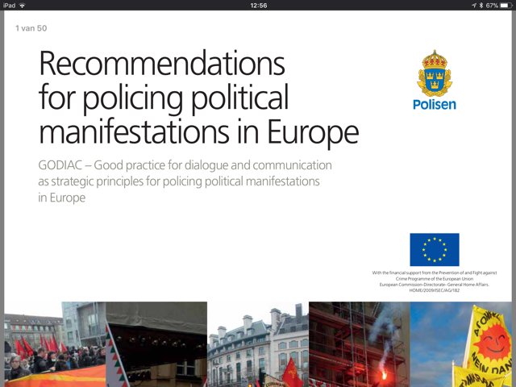

Slide 6
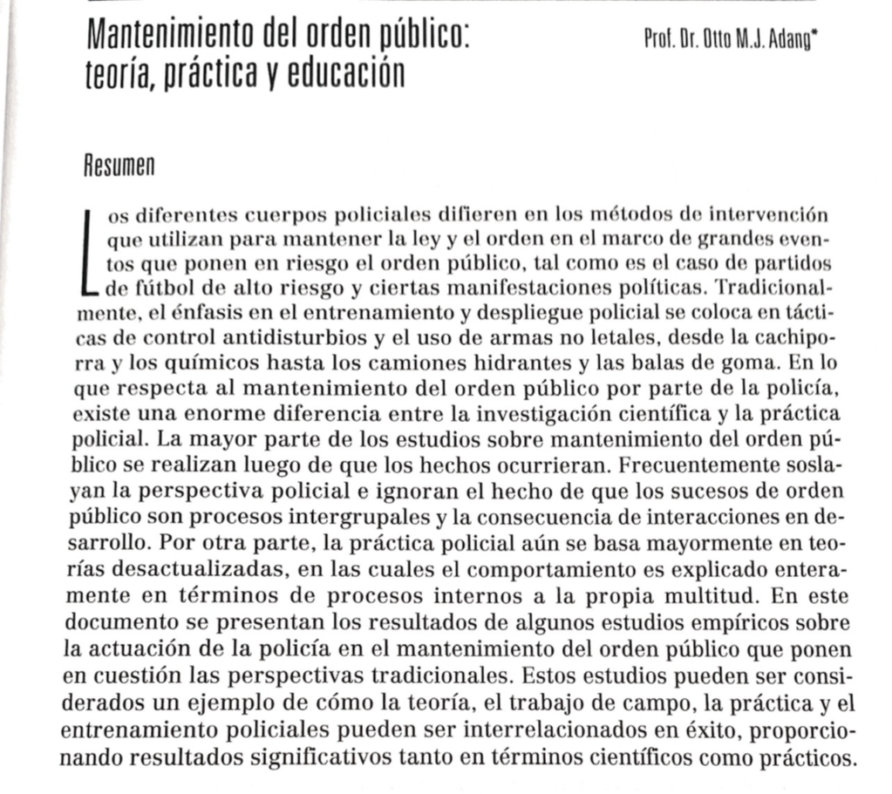
Adang, O.M.J. (2006) Mantenimiento del orden público: teoría, práctica y educación, Cuadernos de Seguridad, No 1 08-2006, p 79 - 95. Consejo de Seguridad Interior, Buenos Aires, Argentina

Slide 7
Initiation/ escalation model
initiation of violence:
  “frictions”
  “young male syndrome”
escalation of violence:
  opportunity/ perception of risk
  ingroup/ outgroup mechanisms (`us vs. them`)
normal social mechanisms are operating, but influence of alcohol and drugs

Slide 8

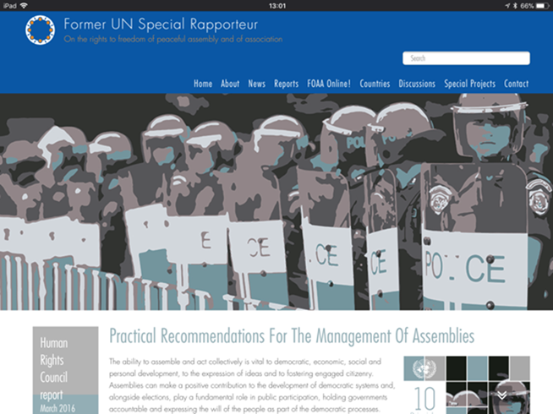

Slide 9
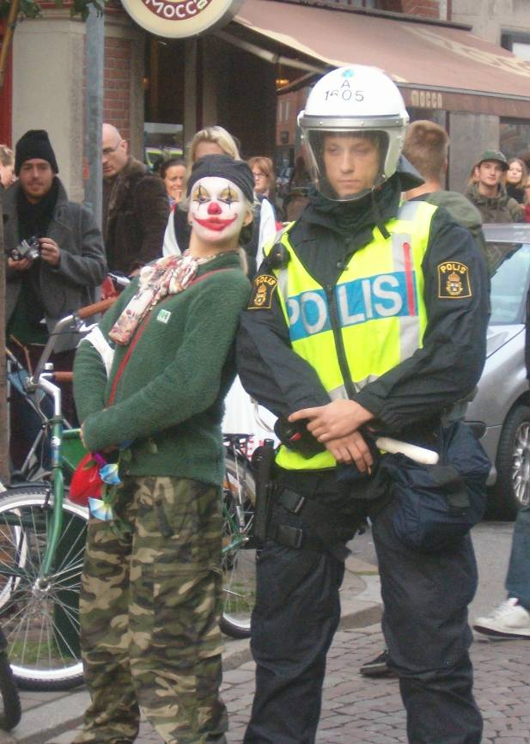
Public order management
The systematic planning for, and supervision of, events in the public domain that carry some risk for public order, irrespective of the number of people gathering/ expected to gather

Slide 10
NO phases!!!!!
Crowd management Crowd control Riot control
dialogue de-escalation direct action

Slide 11
Public order management
Crowd
management
Crowd control
Riot
control

Slide 12
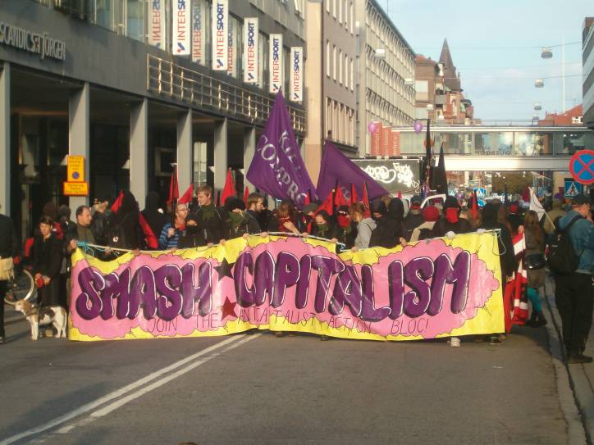
Gathering for a purpose
GOAL

Slide 13
Conflict reducing principles for public order management
Education: know protest and protesters
Facilitation: legitimate intentions
Communication and dialogue
Differentiation: avoid us vs them
(perceived) BALANCE between deployment/ interventions and risks
Reicher, S., C. Stott, J. Drury, O. Adang, P. Cronin & A. Livingstone (2007) Knowledge-Based Public Order Policing: Principles and Practice. Policing, Vol. 1, No. 4, pp. 403-415

Slide 14
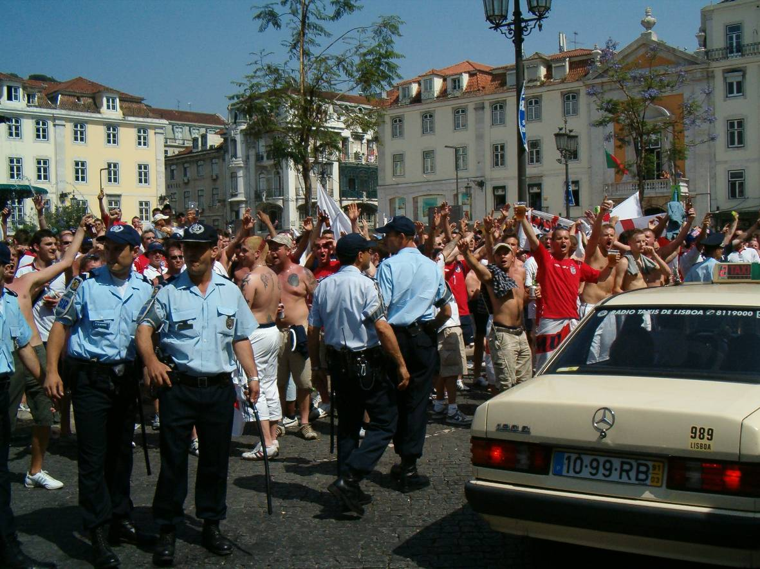
Friendly and firm low-profile approach

Slide 15
Public order management vs traditional riot control
PUBLIC ORDER MANAGEMENT Emphasis on order In cooperation with safety partners Communication and interaction Facilitating legitimate intentions Interventions based on behaviour Low profile, friendly and firm Setting boundaries with focused, timely interventions | RIOT CONTROL Emphasis on disorder and crime Police main actor Distance from public Us versus them Little or no differentiation High profile, show of force Reactive

Slide 16
Police can do a lot to prevent violence, but little to stop it

Slide 17
Less Lethal Weapons: Police Technology Assessment
Weapon & Technology complex
Target complex
User Complex
Outcome
Needs & expectations
Operational
Context
Political societal context

Slide 18
The Netherlands: new concept since 2013
Public order management approach, with focus on dialogue, de-escalation and flexible up- and downscaling
Mobile units: regular officers with dedicated training
Training and deployment based on conflict reducing principles
Police Technology Assessments for decisions with regard to less lethal weapons
Peer reviews to foster organisational learning

